Slide 1
Load metrics
Load education series 2025

Slide 2

Load metrics
Load data contain various metrics. The metric identifier is field UOM_CD (Unit of Measure Code)
The mostly used is ‘dollarized load’ with UOM_CD ‘REV’. But there are also following metrics used. Some of them are relevant only to 1 brand, some of them are used for all brands.
MEASURE | PLATFORM / BRAND | IDENTIFIED BY | COMMENTS
Quantity | ALL Platforms | UOM_CD = ‘QTY' | Represents order quantity
Revenue | ALL Platforms | UOM_CD = ‘REV' | Represents estimated “dollarized” load
Hardware Engines (Entitled Hours) | System Z | UOM_CD = ‘ENH' | Represents the total entitled CPU hours. Important for capacity planning and fair share analysis. Used to measure how much processing time the partition is entitled to receive under PR/SM (Processor Resource/Systems Manager) rules.
Microcode Engines (Entitled MSUs) | System Z | UOM_CD = 'ENM' | Refers to Entitled Million Service Units, which is the MSU capacity allocated to an LPAR based on its defined weight and share. Also known as "revenue" engines and only applies to upgrades. Does not require new manufacturing as the engine capacity was included in the original "box" shipment (ie. the "dormant" engines)
MIPS | System Z | UOM_CD = 'MIP' | A measure of processing capacity, indicating how many millions of instructions a processor can execute per second.
CECS (Central Electronic Complex) | System Z | UOM_CD = 'CEC' | The CEC is the hardware unit that contains: CPs (Central Processors) – General-purpose engines. Specialty engines – zIIP, IFL, zAAP (for specific workloads). Memory and I/O subsystems.
Gigabytes | Storage Only | UOM_CD = 'GIG' | Storage capacity (1 terabyte = 1,000 gigabytes)
MEASURE | BRAND | IDENTIFIED BY | COMMENTS
List Value | ALL Platforms | UOM_CD = ‘LV’ | Represents fully configured List Value
Invoice | ALL Platforms | UOM_CD = ‘INV | Invoice information, when available from source

Slide 3
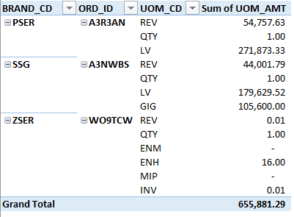
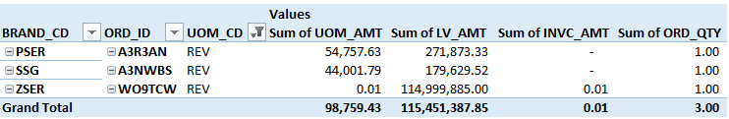
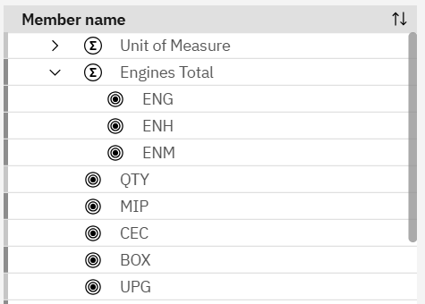
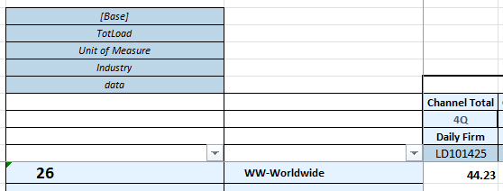
Metrics in Load Data (example on 3 orders A3R3AN, A3NWBS, WO9TCW)
DB2 query There is also possibility to see the metrics when only UOM_CD = ‘REV’ is used
UOM_CD = ‘LV’ is also found in column LV_AMT & UOM_CD = ‘REV’
UOM_CD = ‘INV’ is also found in column INVC_AMT & UOM_CD = ‘REV’
UOM_CD = ‘QTY’ is also found in column ORD_QTY & UOM_CD = ‘REV’
Cognos Daily Load File
In Load cube (Loadtgts) they are specified in dimension ‘Unit of Measure’
3.
1.
1.
2.
3.
3.
1.
1.
2.
3.
3.
2.

Slide 4
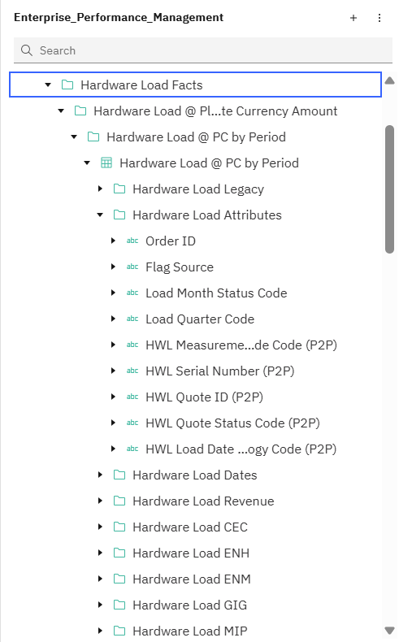
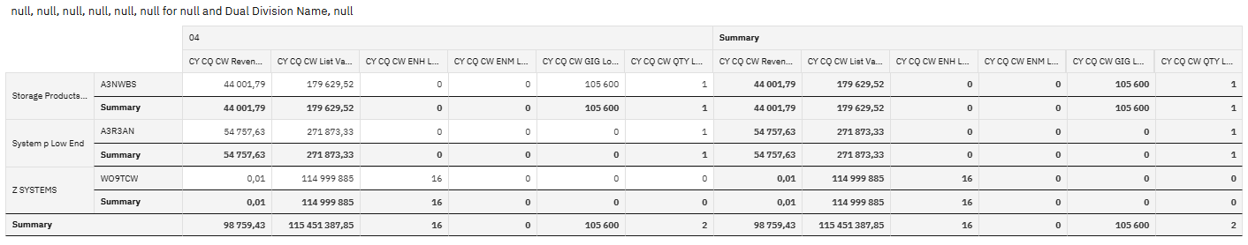
Metrics in Load Data (example on 3 orders A3R3AN, A3NWBS, WO9TCW)
EPM

